Slide 1
COMP28112
Distributed Computing
It’s been three months since the first lecture…
We went a long way…
We covered a number of topics…
Let’s see some…
Marking session for the lab on May 5th & 8th All your lab work should be marked by May 8th!
COMP28112 Lecture 18

Slide 2
Back in January I said (lecture 1)
Be flexible, keep an open mind, etc...
We’re doing engineering :
  not an exact science...
    but, basic exact science skills are essential (e.g., how long will it take to transmit a message of size 4MB over a network link with speed 256KB/sec?)
  constraints, optimisations, ...
  unreasonable (or infinite) demands, ...
  imperfections, trade-offs, ...
  Distributed Systems typically encompass a number of such trade-offs!
COMP28112 Lecture 18

Slide 3
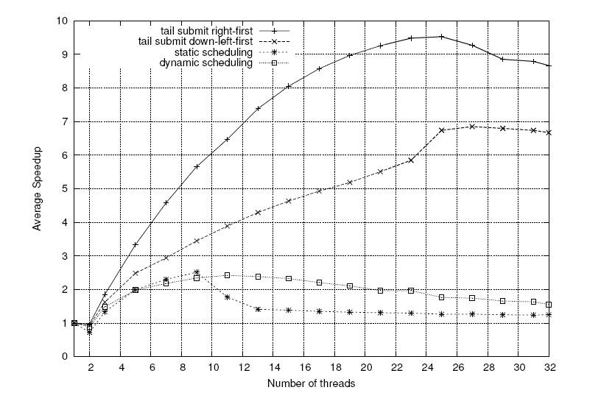
Mesa et al, “Scalability of Macroblock-level Parallelism for H.264 Decoding”
COMP28112 Lecture 18

Slide 4
Then…
2: Parallel Computing, Amdahl’s law…
3: Architectures, client-server, etc…
4-7: RPC/RMI, intro to lab exercise 2
8: Name and Directory Servers
9: Lamport/Vector Clocks
10: Election of a leader (coordinator)
11-12: Transactions
COMP28112 Lecture 18

Slide 5
… (cont)
13: Byzantine Fault Tolerance
14: Lab 3 – simulation and modelling
15: Replication
16: The Integration Game
17: Some interesting problems (and more)
+ two guest lectures
COMP28112 Lecture 18

Slide 6
and we could have said more on:
Security
Distributed File Systems
Distributed Shared Memory
Peer-to-Peer Systems
Mobile Computing
Web Services
Sensor-based applications
Energy minimization
Cloud Computing
Performance
…

Slide 7
…above all, we tried to examine a way of thinking that allows us to design and build ‘good’ distributed systems!
COMP28112 Lecture 18

Slide 8
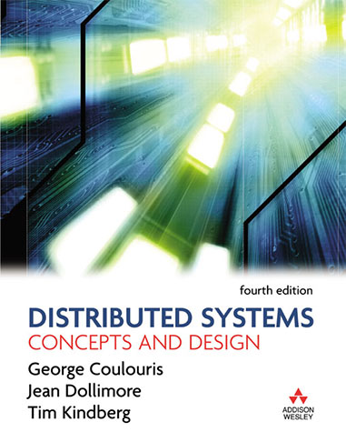
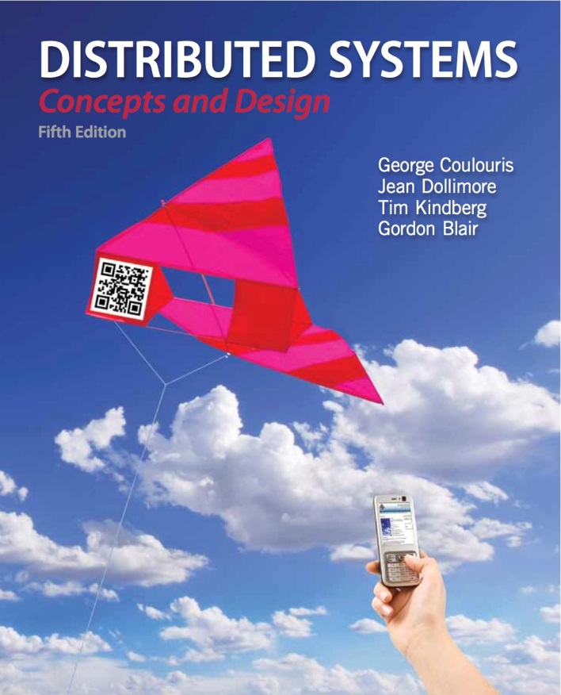

for more information… the recommended textbooks have a range of pointers
COMP28112 Lecture 18

Slide 9
Towards the exam…
This is the 9th year of COMP28112 (COMP20032 earlier)
Past exams are available from the University’s central repository
This module’s webpage:
http://studentnet.cs.manchester.ac.uk/ugt/COMP28112/
Lecture handouts are all there! (plus hardcopies outside the Resource Centre)
When looking for the module’s page please make sure that you don’t see last year’s web page!
COMP28112 Lecture 18

Slide 10
The exam
Four questions:
  You must answer Question 1
  You choose any two from Questions 2, 3, 4
Check past papers for style
COMP28112 Lecture 18
All lab marking should be completed by May 8th

